Slide 1

Internet of Things (IoT)
Resourcing the event
Guillermo Ramirez-Prado

Slide 2
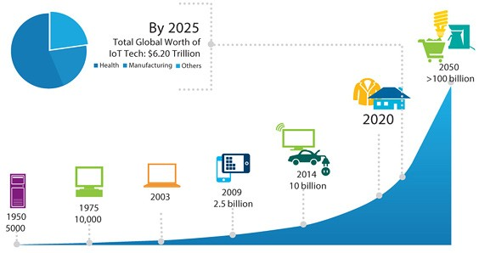

Slide 3
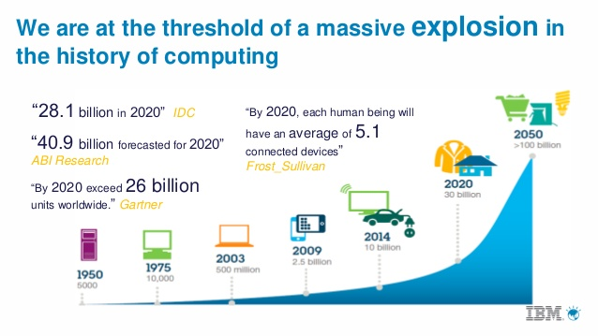

Slide 4
What is IoT?
Internet of Things (IoT)
Internet of Everything (IoE)
Thing
+
Computational inteligence
+
Network

Slide 5
What is IoT?
Thing
To enhance
To improve
Same interface
Works the same

Slide 6
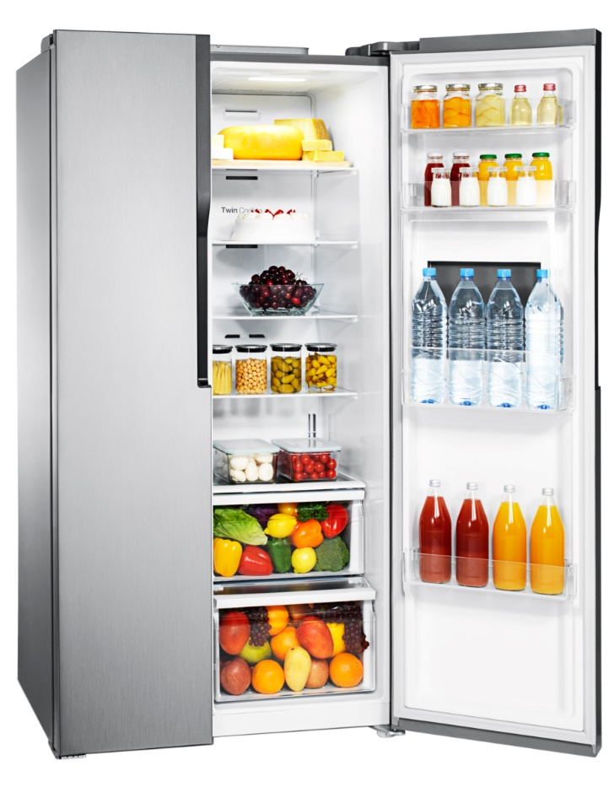


Smart home

Slide 7
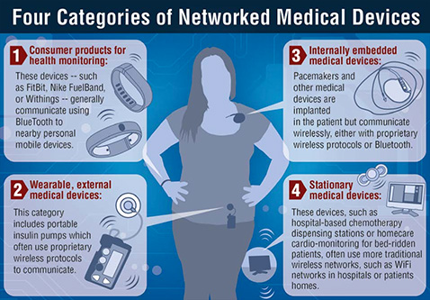
Networked Medical Devices

Slide 8
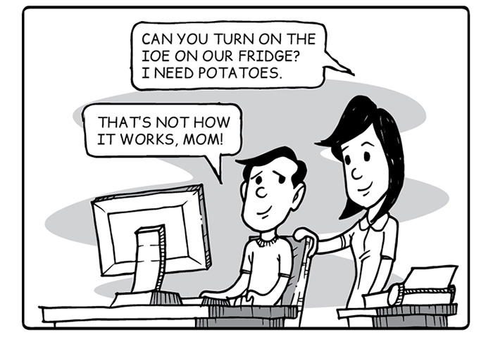
The IoE

Slide 9

How does it work?
LAN
WiFi/Ethernet
Connectivity
Thing

Slide 10
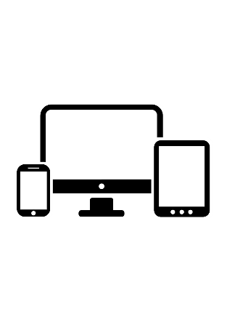
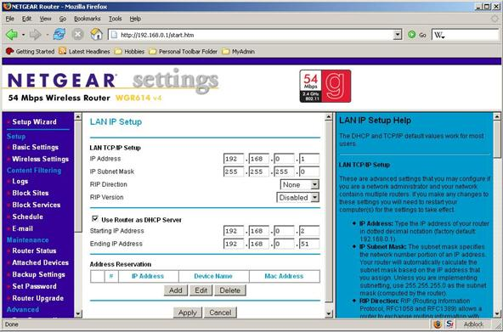
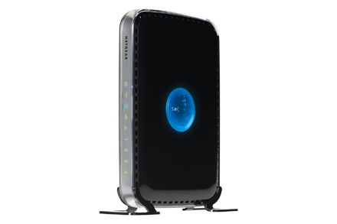
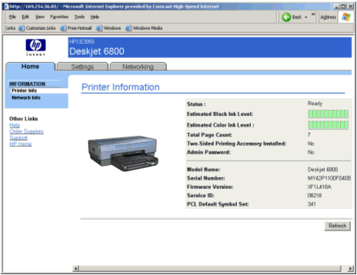
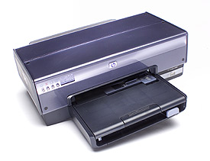
A good start
LAN
(TCP/IP)
Microprocesor
+ minimal system
+ web server
IP: 198.162.1.x

Slide 11

A general framework
LAN
WiFi/Ethernet
Interface
(TCP/IP)
Actuators
Microprocesor
+ minimal system
+ web server
Sensors

Slide 12
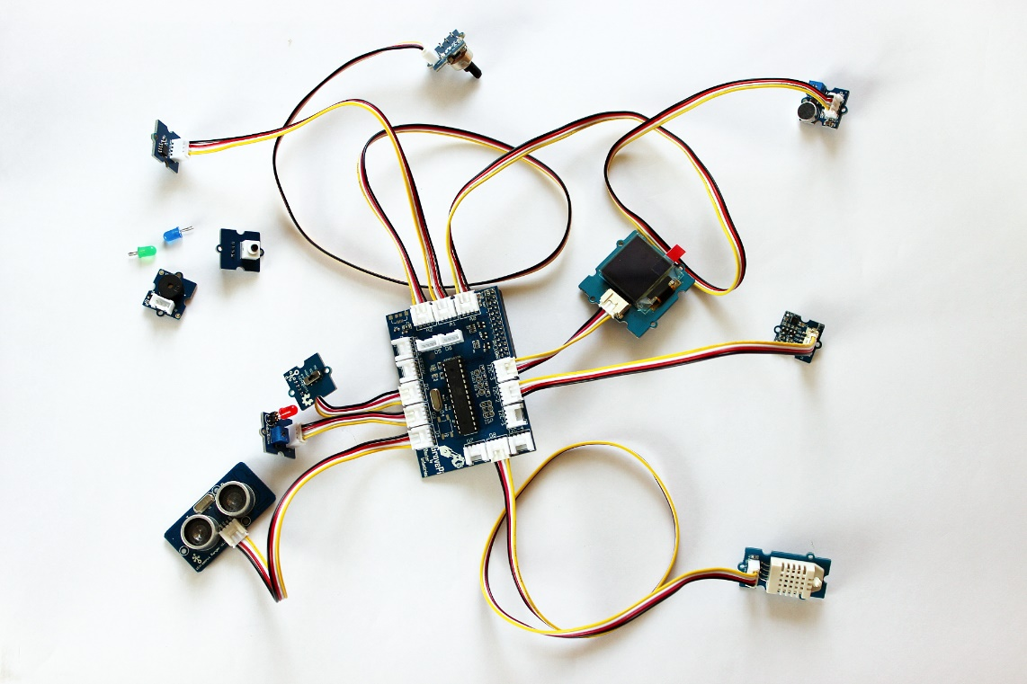
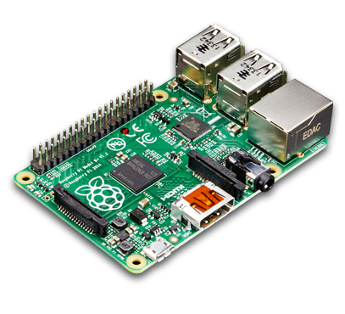
A general framework
LAN
Microprocessor
and Interface
Sensors and
actuators

Slide 13

IP: 192.168.1.x
device
IP:192.168.1.x
device
IP:192.168.1.x
device
IP:192.168.1.x
device
IP:192.168.1.x
device
IP:192.168.1.x
device
IP:192.168.1.x
device
IP:192.168.1.x
device
IP:192.168.1.x
device
IP:192.168.1.x
device
IP:192.168.1.x
device
IP:192.168.1.x

Slide 14
LAN
device
IP:192.168.1.x

Slide 15
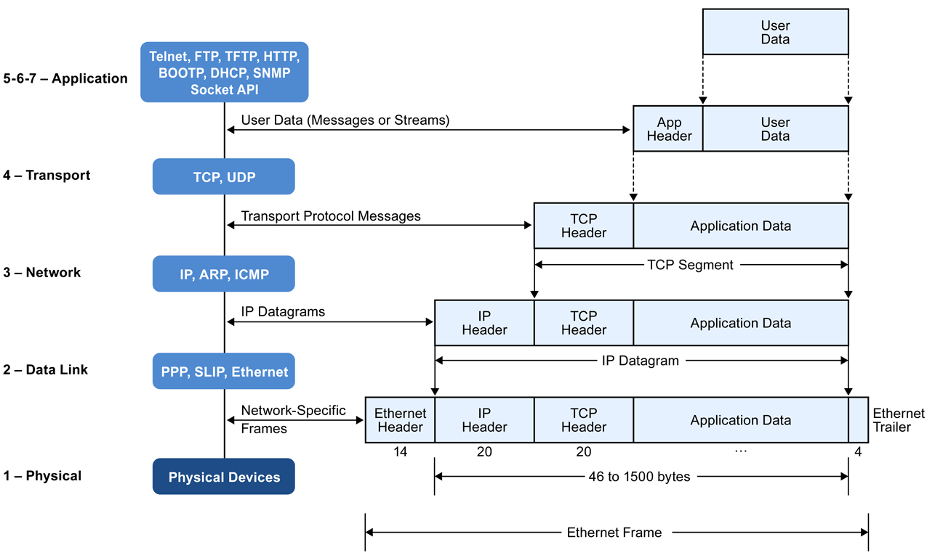

Slide 16
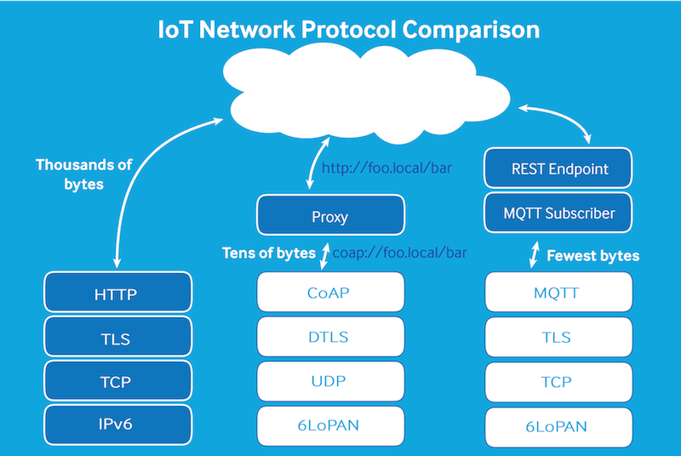
MQTT and CoAP

Slide 17
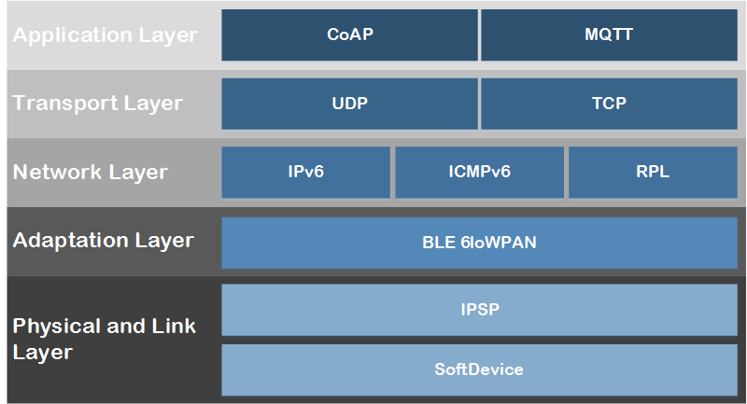
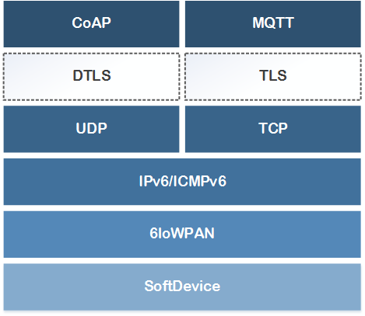
MQTT and CoAP

Slide 18
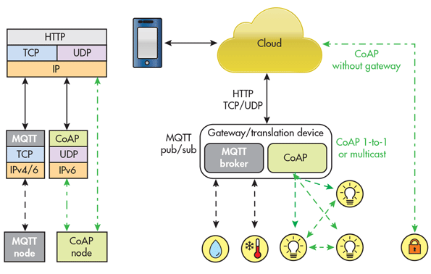

Slide 19
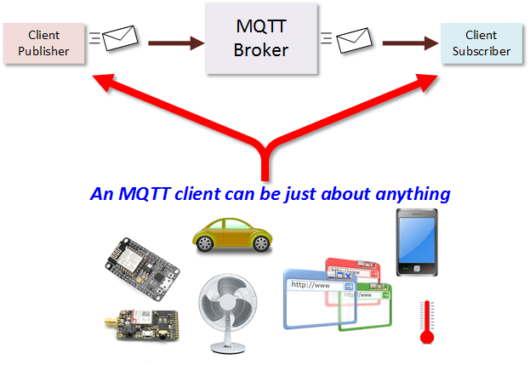

Slide 20
MQTT
LAN
MQTT
TCP/IP
IBM’s Message Queuing
Telemetry Transport
Device
IP:192.168.1.x

Slide 21

Private Cloud
MQTT
Broker
Device
IP:192.168.1.x

Slide 22
MQTT
Broker
Device
IP:192.168.1.x

Slide 23
IoT Brokers
Suscription (on demand)
IBM Cloud
Online public brokers
HiveMQ
cloudMQTT
Eclipse
CloudMQ
EasyIoT
Thinkspeak
MQTT Broker App (Android)

Slide 24
OpenSource
MosQuiTTo
VerneMQ

Slide 25
MQTT Clients
MQTT.fx
Mqtt-spy
HiveMQ Client
MyMQTT (Android, iOS)
MQTT Dash (Android)
MQTT Buddy (iOS)
MQTT inspector

Slide 26
Activity
Set up a public broker
Use a client to connect to public broker

Slide 27



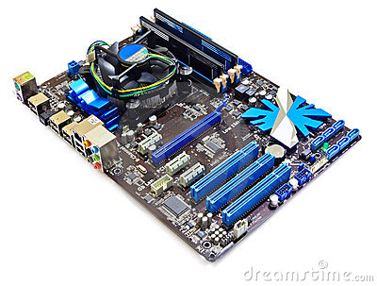
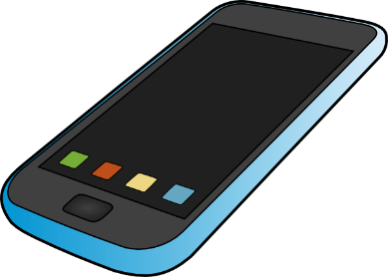
IoT devices Computers, tablets, smartphones

Slide 28
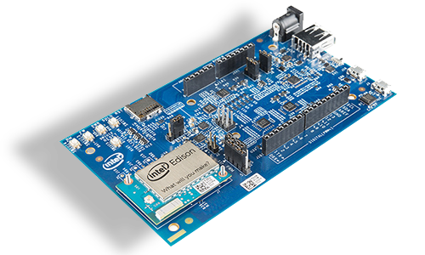
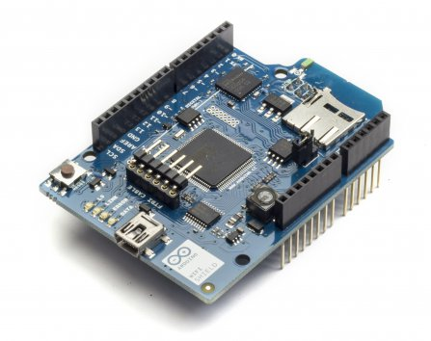
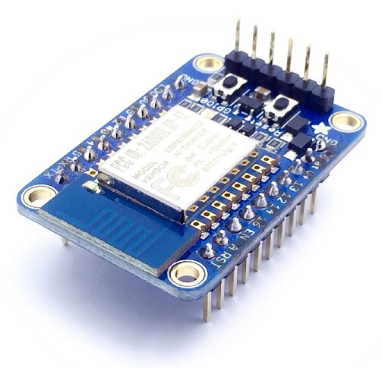
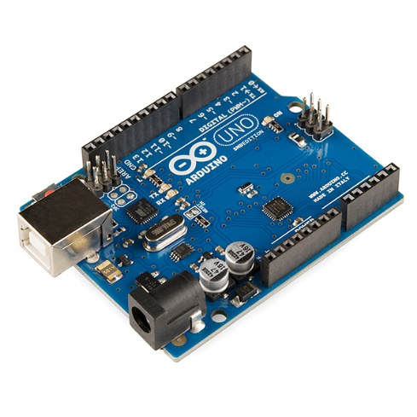
IoT devices Embedded systems

Slide 29
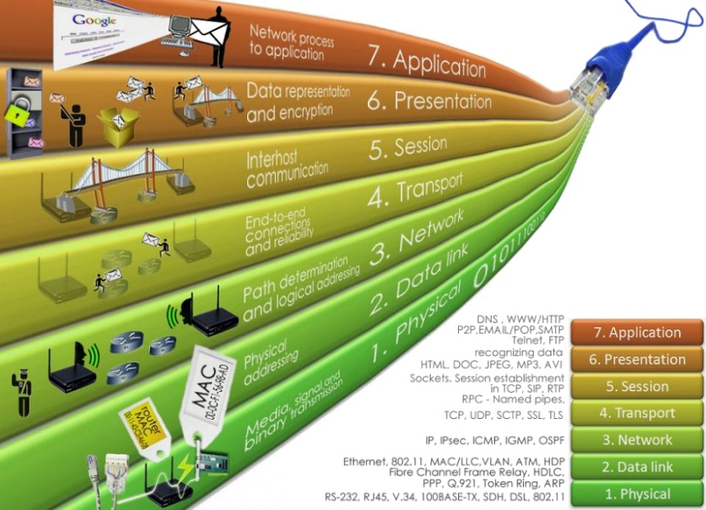
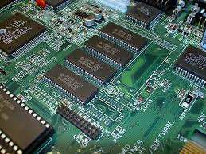
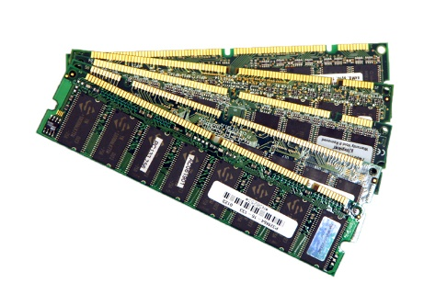
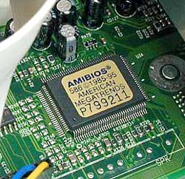
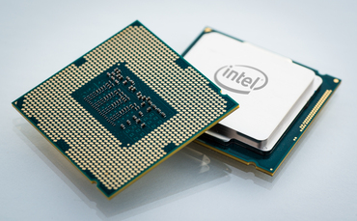
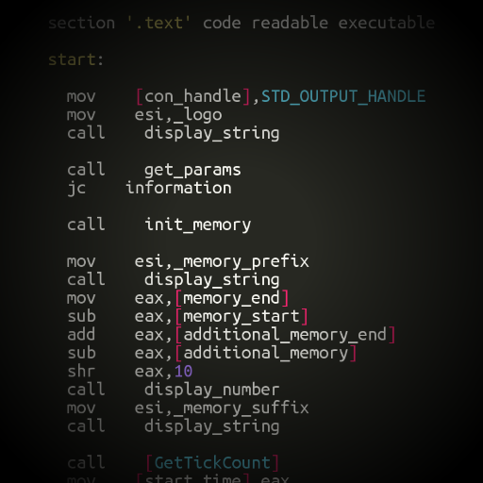
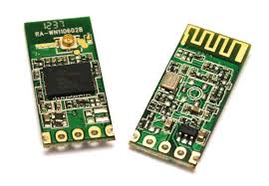
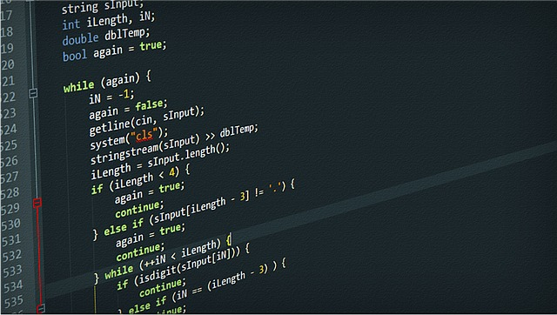
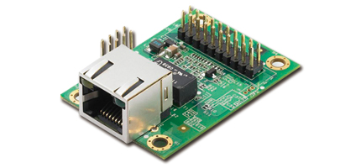
IoT devices

